Slide 1
Learning Styles, SQ3R and Note Taking Orientation
Study Smarter, Not Harder!

Slide 2
Learning Styles
Please take the short online VARK Learning Styles assessment. http://www.vark-learn.com/english/page.asp?p=questionnaire
What you need to know about your scores is:
  one learning style is not better than the other
  each persons individual learning styles is simply the manner in which their brain makes memories to recall information
  our learning style varies from subject to subject depending on our interest and experience levels on that particular subject matter

Slide 3
Learning Styles Con’t
  For example:
  If I needed to learn chemistry, I would most likely
  need to use more than one learning style to recall
  the information.
  On the other hand, if someone wanted to teach me
  something about baseball, I would probably only
  need to hear the information in order to teach it to
  someone else.

Slide 4
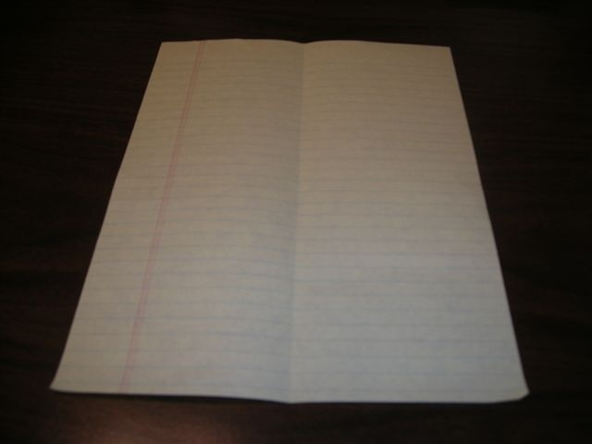
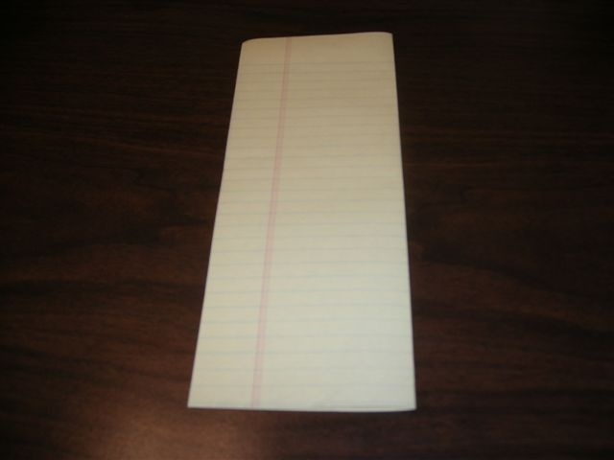
Fold a sheet of notebook paper in half, vertically.

Slide 5
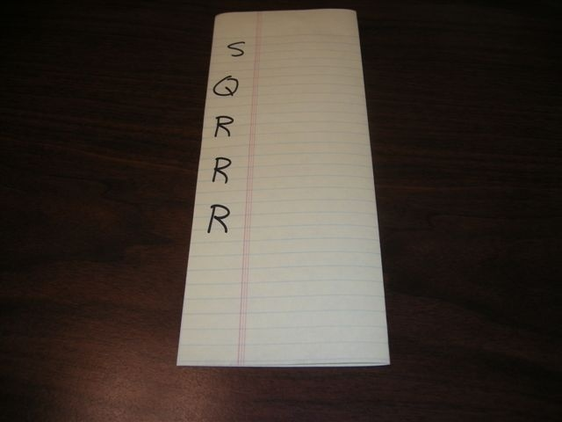
Write S Q R R R on the paper

Slide 6
Be sure to write down/copy everything you see on the note paper for the rest of this presentation.

Slide 7
The SQ3R helps break down the information in a chapter or section of a chapter into building blocks.

Slide 8

S - Survey
Write Survey next to the S on your paper
The first thing you do when you have a section to read is SURVEY the material by
highlighting, underlining, ,
putting a check mark ( ) , or star ( )
by/on:
  Headings, bold words, anything in italics, charts, graphs, chapter overview or summary
circling

Slide 9
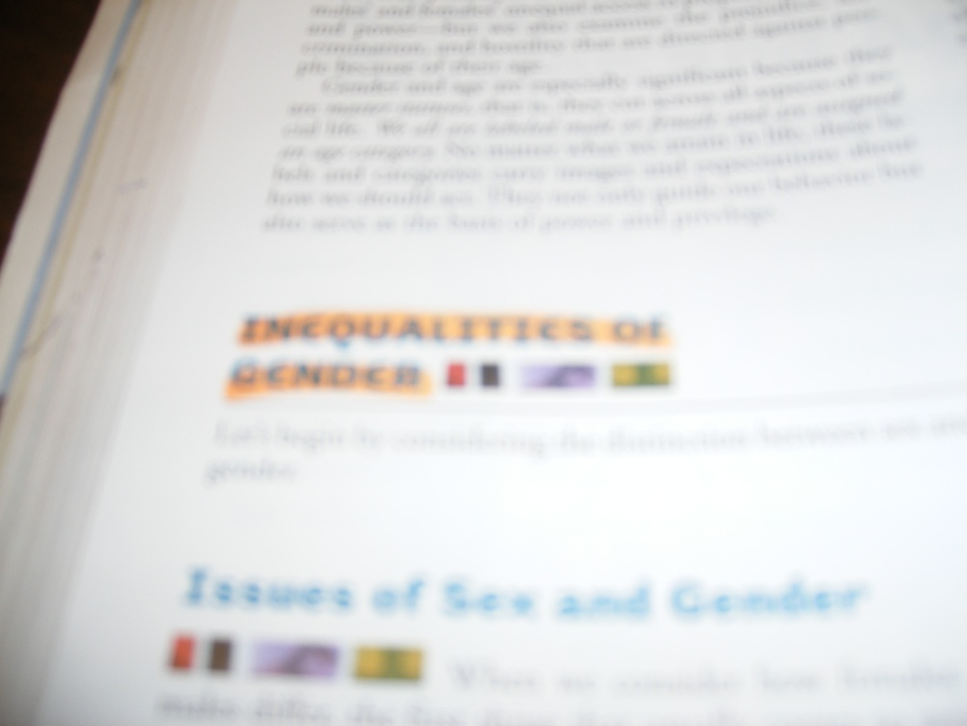
S – Survey Headings

Slide 10
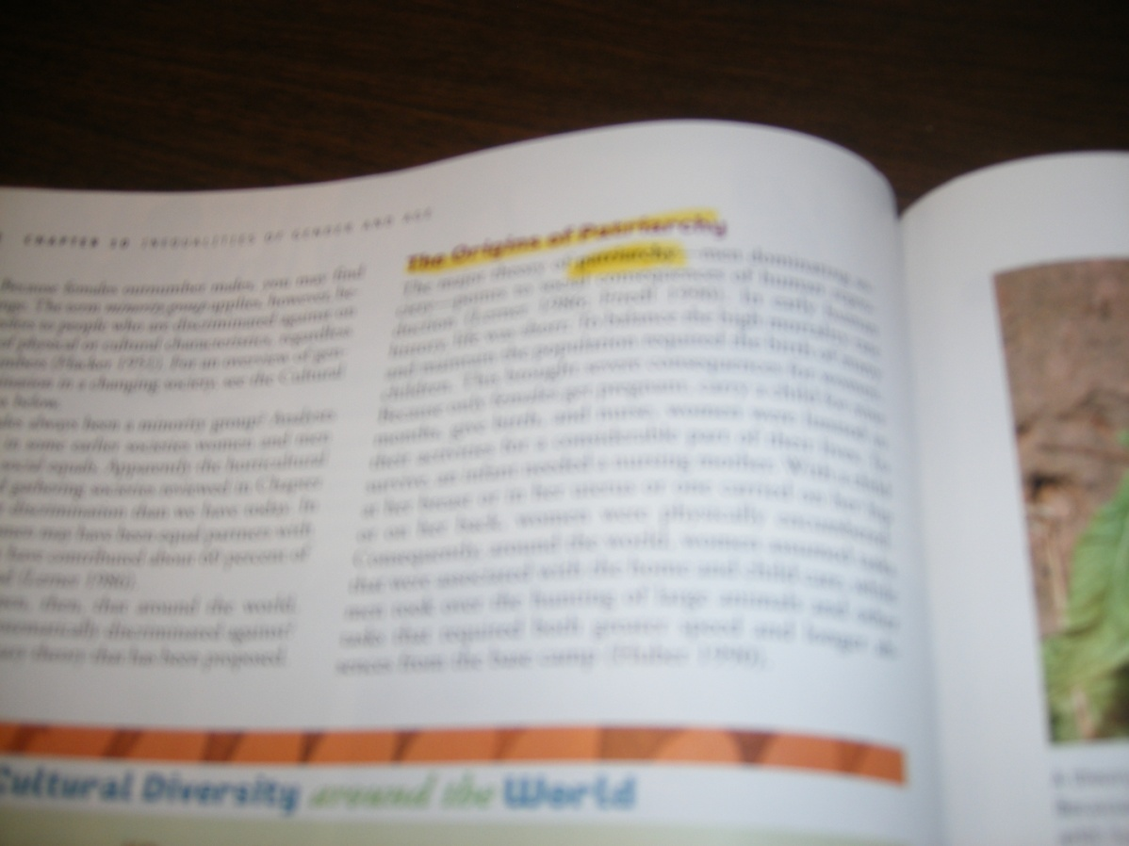
S – Survey Bold Words

Slide 11
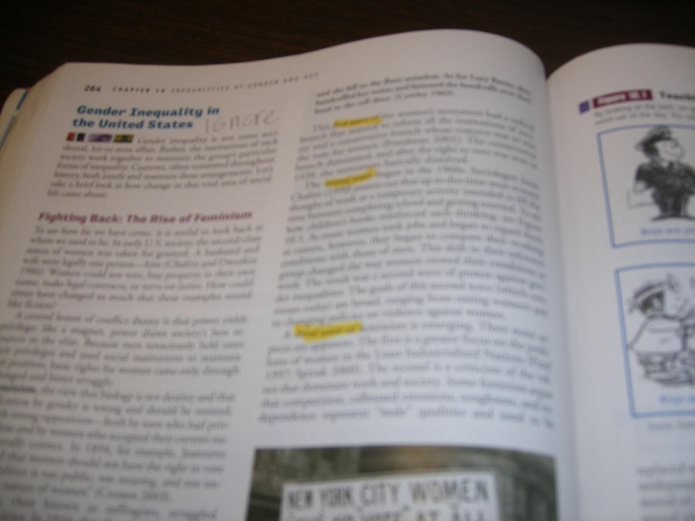
S – Survey Italic Words

Slide 12
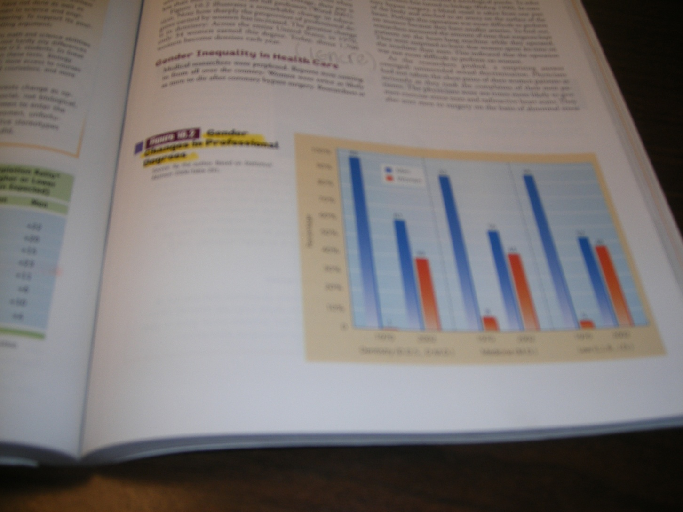
S – Survey Graphs

Slide 13
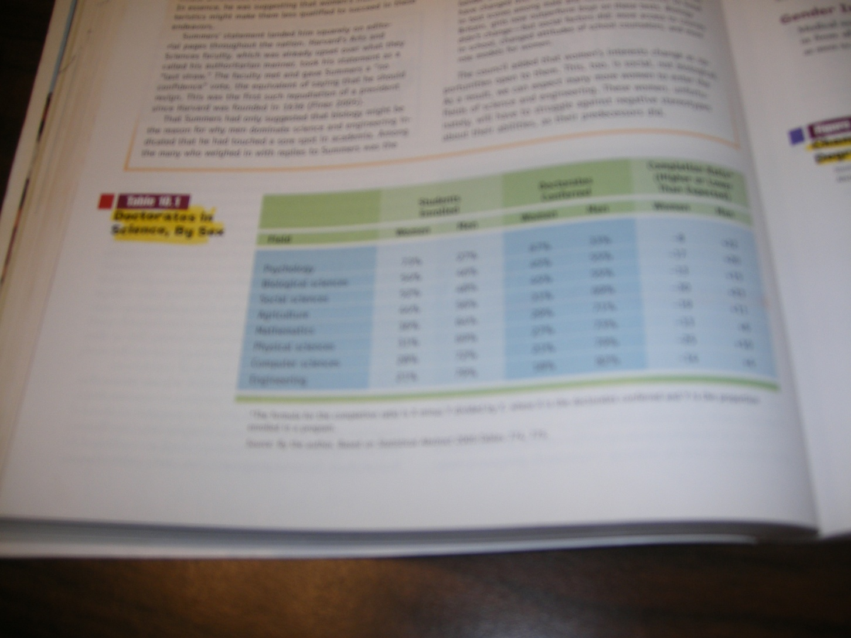
S – Survey Charts

Slide 14
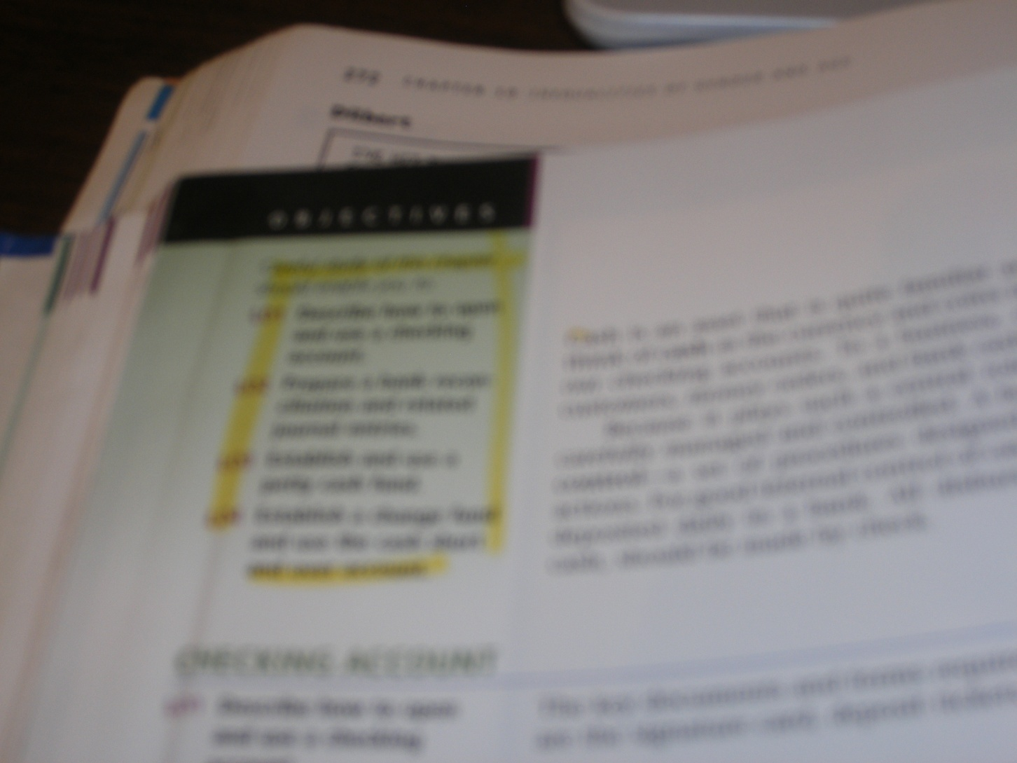
S – Survey Chapter Overviews

Slide 15
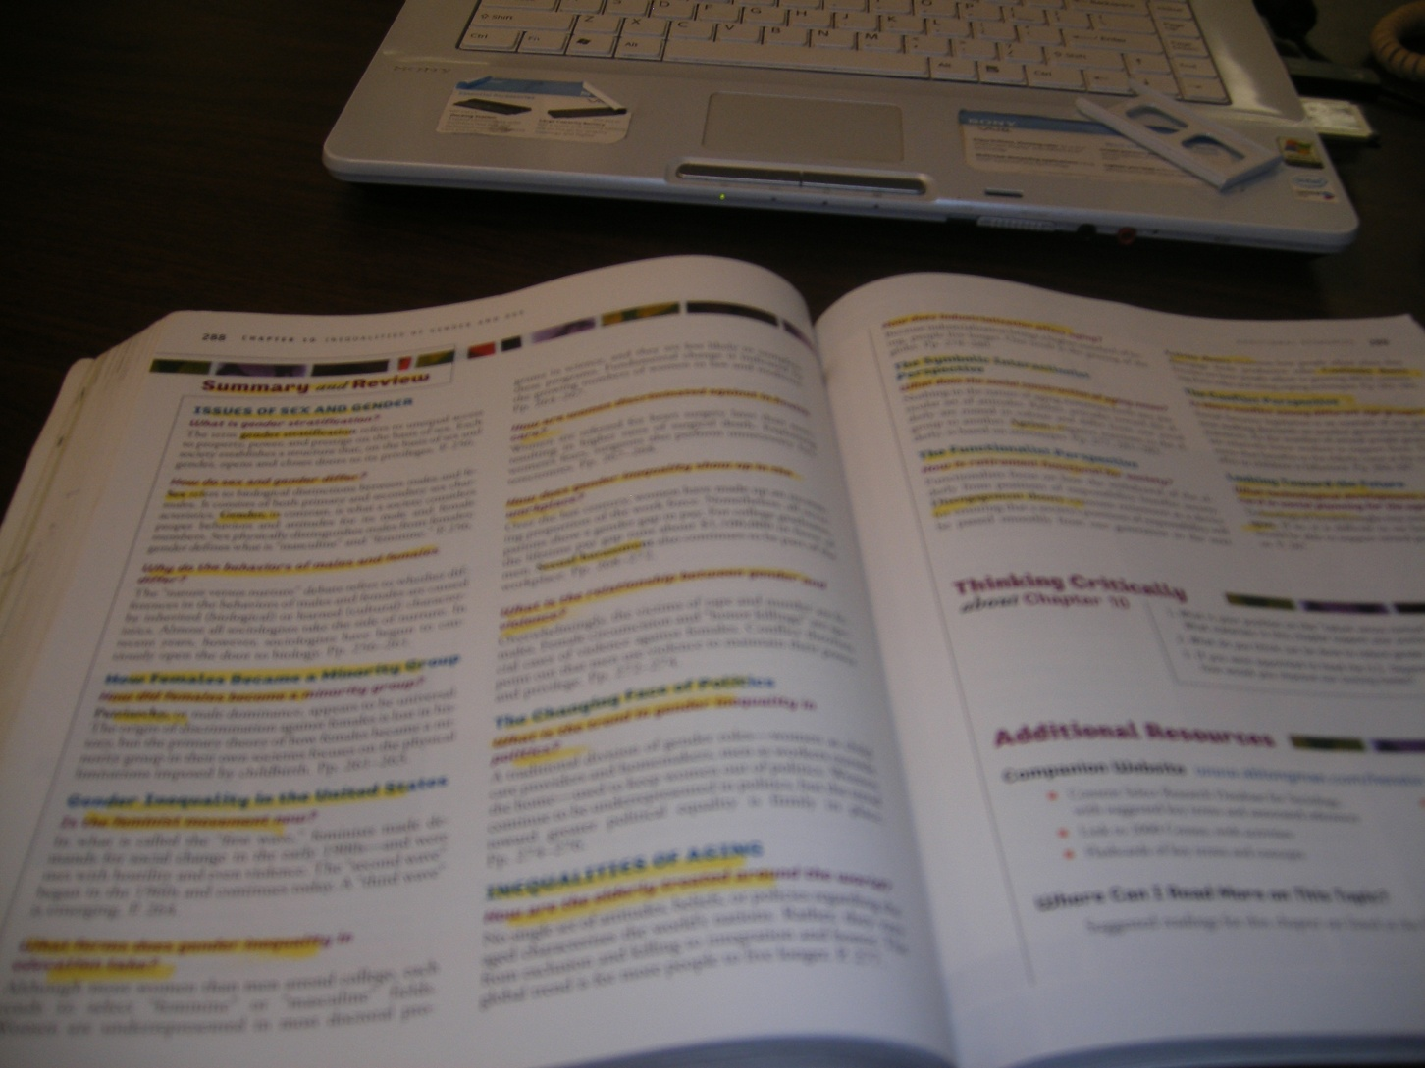
S – Survey Chapter Summaries

Slide 16
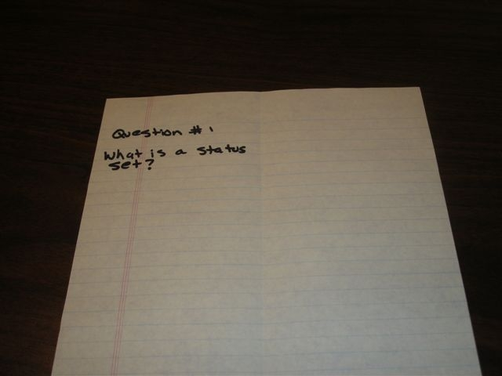
Q - Question
Turn each concept you surveyed into a question and write it down in the margin of the book OR on the left side of your paper.
Write Questions #1 on the left top side
For example:

Slide 17
Q - Question
Leave plenty of space after Question #1
Repeat by writing Questions/Concepts #2 and #3 on your paper
Write 3 – 4 questions/concepts/terms per page while leaving space between each.

Slide 18
1st R - Read
Next you will Read with a purpose to find the answers to the questions you wrote in the margins.
Only read around what was Surveyed to answer the Questions

Slide 19
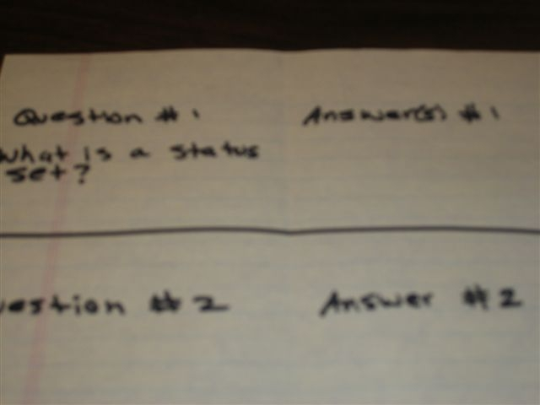
1st R - Read
Write your answers / explanations in the margin or the right hand side of the paper across from the questions/concepts/terms

Slide 20
2nd R - Review
Now review the Questions and Answers in your margins.
Always say the answers out loud to confirm understanding.

Slide 21
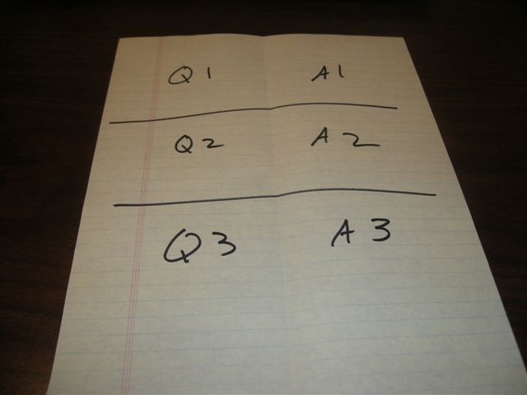
2nd R - Review
Also, review the Q & A on the paper:
  Open-faced

Slide 22
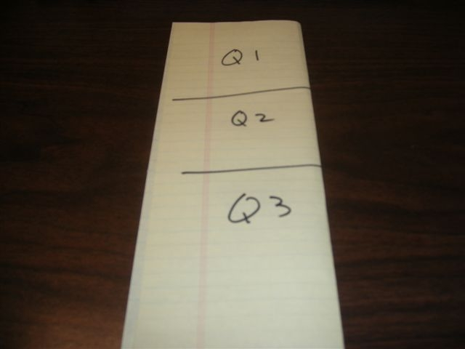
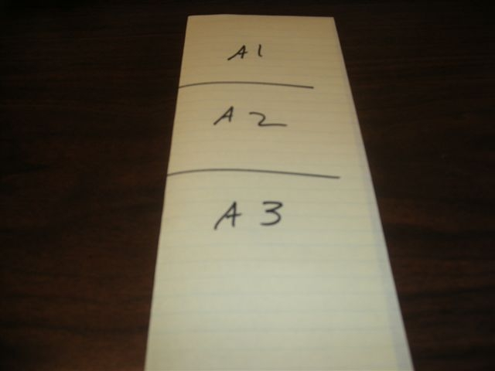
2nd R - Review
Review the Q & A on the paper:
  You can Quiz yourself by folding the paper, asking the question and answering out loud without looking at the answer.

Slide 23
2nd R - Review
Review the Q & A on the paper:
  You can play JEOPARDY by saying the answer and answering in the form of a question.

Slide 24
3rd R - Reread
Reread the concepts you have difficulty remembering.
Then Review the concepts, Reread them, Review them, Reread and Review again.
You are now building experience with the material, which will help you remember the information for the test.

Slide 25
SQ3R In Review
Now you have added the invaluable
textbook reading skills in the SQ3R:
S – Survey the material
Q – Question what was surveyed
R – Read to answer what was Questioned
R – Review your Questions and Answers
R – Reread the most difficult concepts

Slide 26
Note Taking
The note paper you have been taking
notes on is exactly how you should take
notes in class and when you are reading a
textbook to breakdown the information
using the SQ3R.
Do you make note cards?

Slide 27
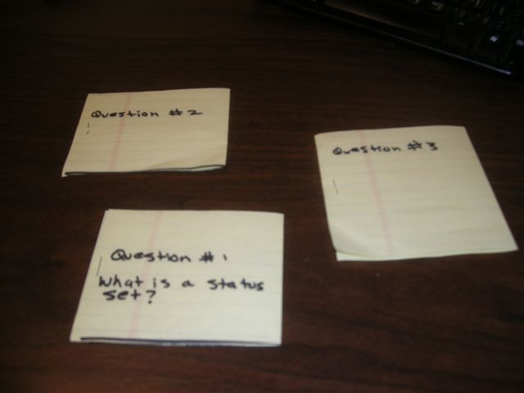
Note Cards
If you don’t already make note cards, then you can cut your paper/notes below the Q&A, then staple or tape the paper to create note cards.

Slide 28
When to Study?
First chance you get after class
The night before the class
10-15 minutes before class
In your car at the Whataburger drive-thru
In the lunch line or while eating
While your riding in the car with family

Slide 29
Experience
You are gaining experience with the material
The more experience you gain with the material, the better you will be able to recall the information.
The experience creates memories for you to recall the information during tests.

Slide 30
Math
The formula is the “KEY” to the answer
The formula has procedures to get to the solution.
  Step 1
  Step 2
  Step 3

Slide 31
Math
How do you try to remember the formula for the test?
You try to MEMORIZE it!
That’s wrong!
You need experience with the formula, so…
Practice writing the formula with every practice, homework or test problem!

Slide 32
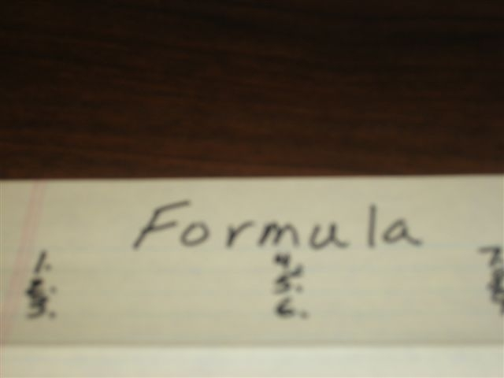
Math Notes
Write your formula and procedures for a problem at the top of the page.

Slide 33
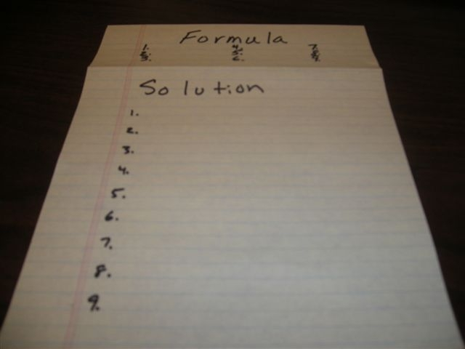
Math Notes
Write your solution and procedures for a problem at the bottom of the page.

Slide 34
Proper Repetition
Proper repetition gives you constructive experience with material, which helps to recall the information for the test.

Slide 35
Don’t forget…
The more tools (study skills) you have, the
better prepared you will be. The better
prepared you are, the more successful you
will be!
Success starts with YOU!

